Slide 1
Classification of Diseased Lung Tissue
By Tyler Whitmarsh
EE 485, S2022

Slide 2
Introduction: What am I trying to solve?
Lung diseases are pervasive in the medical field and I want to leverage machine learning techniques in order to help doctors make a more accurate diagnosis.
Machine learning classifiers can also be used in a testing suites to run any ct scan of lungs through in order to catch things doctors aren’t looking for.

Slide 3
Data Gathering
MedGIFT dataset was used to get the lung images (University hospitals in Geneva)
Dr. Gill in the CS department has previously worked with this dataset so I was able to acquire the dataset from him.
Images are made up of regions of interest of CT scans of lungs
Only preprocessing that needed to be done was converting all images into a csv file with labels
Original dataset had 9 diseases, Only 5 diseases were selected due to small sample sizes of other diseases

Slide 4
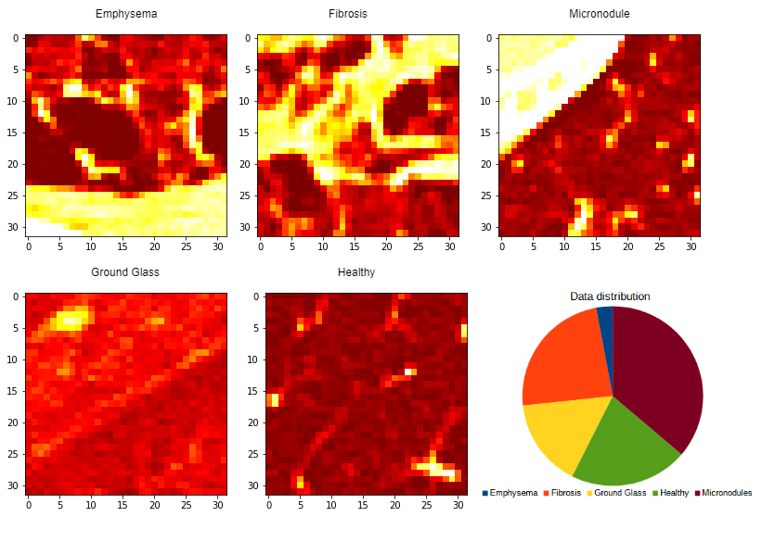
Data Visualization
Around 90,000 images total
of 5 diseases: 32x32 size
Emphysema - 2,706 images
Fibrosis - 21,598 images
Ground Glass - 14,519 images
Healthy - 19,293 images
Micronodules - 32,997 images

Slide 5
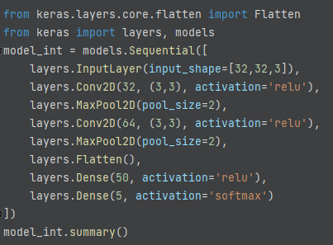
Building my CNN model
Started with a simple CNN model to make sure data was being processed correctly and I was able to get a good output
Train test split of 50/50
Using the ‘Adam’ optimizer
50 epochs

Slide 6
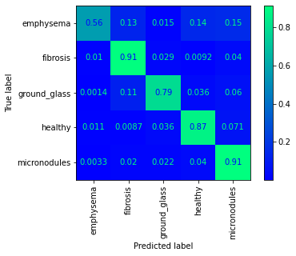
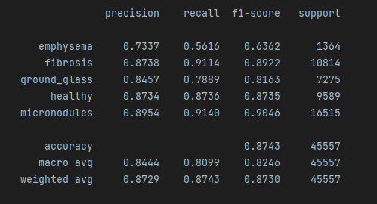
Initial CNN Model Results
Initial model had poor results: With low recall

Slide 7
Tuning my model
The book covered models that had been successful in the image net competitions and I used those as a base for setting up my own model.
Features that I noticed from these imagenet models that I utilized in my newer model
Multiple convolution layers stacked before a maxpool
Same padding
Mixed use of activation
High dropout levels around 50%
Normalization between every few layers

Slide 8
New Fine tuned model
I built a new model based on my research and reading in the book about different architectures for CNN networks.
I used some fine tuning to test:
different activations: RELU, Leaky RELU, ELU, Sigmoid
layers depths: 1-3 convul ‘blocks’, 1-3 dense layers
convolution kernel sizes: (2,2) vs (3,3)
Batch normalization layers: where to include
dropout rates: 20% - 40%
Convul block was two convul layers and a normalization layer together
Used the ‘Adam’ optimizer

Slide 9
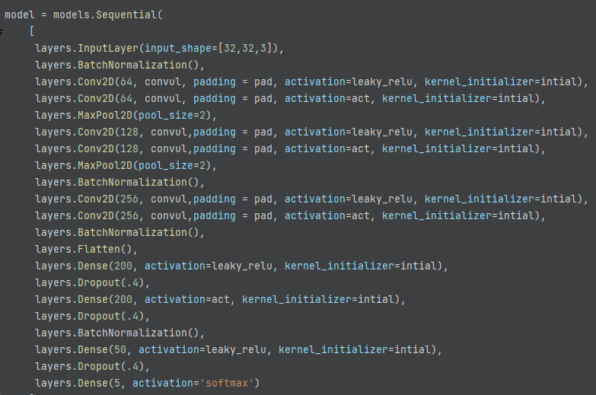
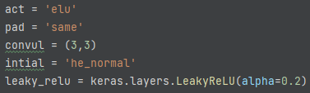

Slide 10
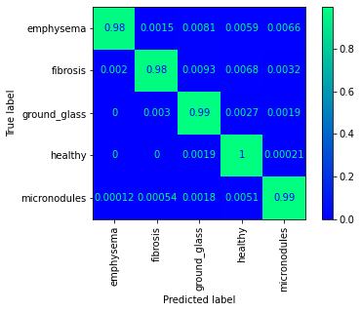
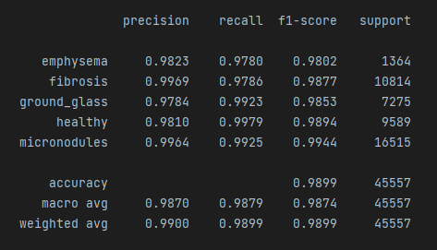
Results of the fine tuned model
New model performed much better than before and I was able to improve the recall of the categories with less images

Slide 11
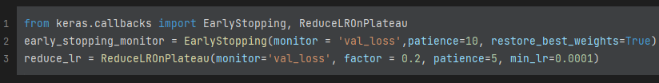
Future Work and where to go from here
Fine tuning model more to see If I can get the same results with a smaller model that is faster to run.
Using this model to train on the full nine disease dataset
Creating pipeline to go straight from the CT scan file to model output
Working with callbacks api in Keras to improve model training
Reduce learning rate on plateau
Learning rate scheduling
Early stopping callback

Slide 12
MedGIFT database reference
“Building a reference multimedia database for interstitial lung diseases“. Depeursinge A, Vargas A, Platon A, Geissbuhler A, Poletti PA, Müller H. In: Computerized Medical Imaging and Graphics, 36(3):227-238, 2012.

Slide 13

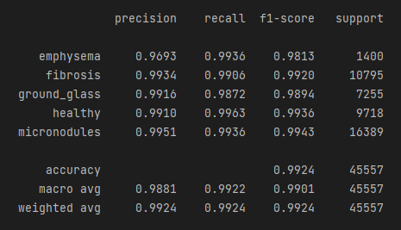
Testing with Callbacks api
40 epochs early stop
50/50 train test split
Reducing learning rate

